Slide 1
Creating Custom Widgets
Teleca Chengdu
Author: Patricia Jiang
Date: July 29, 2010
Version: 1.0

Slide 2
Agenda
1. Customizing Qt Widgets
2. Subclassing QWidget
3. Integrating Custom Widgets with Qt Designer

Slide 3
1. Customizing Qt Widgets
A Qt widget requires more customization than is possible by setting its properties in Qt Designer.
A simple and direct solution is to subclass the relevant widget class and adapt it to suit our needs.
Let’s have an example --- HexSpinBox
You can do like this:
Subclass the relevant widget,
Implement some virtual functions,
Add some special method.

Slide 4
2. Subclassing QWidget
Simply a combination of existing widgets, but need to add some new code , for example, new signal and slot.
1 Create a new form using the "Widget" template.
2 Add the necessary widgets to the form, and lay them out.
3 Set up the signals and slots connections.
If behavior beyond what can be achieved through signals and slots is required, write the necessary code in a class that is derived from both QWidget and the uic-generated class.
If the widget has no signals and slots of its own and doesn't reimplement any virtual functions, it is even possible to simply assemble the widget by combining existing widgets without a subclass.
When none of Qt's widgets are suitable for the task at hand. We must write a new one, subclassing QWidget and reimplementing a few event handlers to paint the widget and to respond to mouse clicks. Eg:QLabel, QPushButton, and QTableWidget.

Slide 5
The IconEditer example(1)
Let's begin by reviewing the header file.
class IconEditor : public QWidget
{
Q_OBJECT
Q_PROPERTY(QColor penColor READ penColor WRITE setPenColor)
Q_PROPERTY(QImage iconImage READ iconImage WRITE setIconImage)
Q_PROPERTY(int zoomFactor READ zoomFactor WRITE setZoomFactor)
public:
IconEditor(QWidget *parent = 0);
……
}
The IconEditor class uses the Q_PROPERTY() macro to declare three custom properties
Properties may be of any type supported by QVariant. The Q_OBJECT macro is necessary for classes that define properties.

Slide 6
The IconEditer example(2)
The implementation file begins with the IconEditor's constructor:
#include <QtGui>
#include "iconeditor.h“
IconEditor::IconEditor(QWidget *parent) : QWidget(parent)
{
setAttribute(Qt::WA_StaticContents);
setSizePolicy(QSizePolicy::Minimum, QSizePolicy::Minimum);
curColor = Qt::black; zoom = 8;
image = QImage(16, 16, QImage::Format_ARGB32);
image.fill(qRgba(0, 0, 0, 0));
}
QSizePolicy::Minimum, widget can be stretched if required, but it should never shrink below the size hint.
Qt::WA_StaticContents, This attribute tells Qt that the widget's content doesn't change when the widget is resized.

Slide 7
The IconEditer example(3)
Void IconEditor::paintEvent(QPaintEvent *event)
{
QPainter painter(this);
……
}
There are many situations when a paint event is generated and paintEvent() is called. For example:
1. When a widget is shown for the first time, the system automatically generates a paint event to force the widget to paint itself.
2. When a widget is resized, the system generates a paint event.
3. If the widget is obscured by another window and then revealed again, a paint event is generated for the area that was hidden (unless the window system stored the area).

Slide 8
3.Integrating Custom Widgets with Qt Designer
Before we can use custom widgets in Qt Designer, we must make Qt Designer aware of them. There are two techniques for doing this:
The promotion approach
The plugin approach

Slide 9
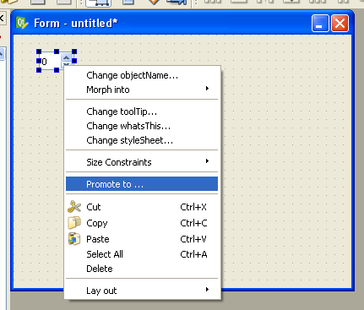
The promotion approach(1)
The promotion approach is the quickest and easiest.
But, the properties that are specific to the custom widget aren't accessible in Qt Designer and that the widget isn't rendered as itself.

Slide 10
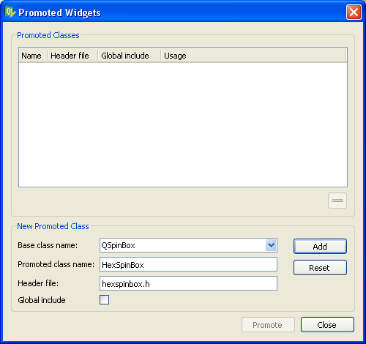
The promotion approach(2)
1. Create a QSpinBox by dragging it from Qt Designer's widget box onto the form.
2. Right-click the spin box and choose Promote to Custom Widget from the context menu.
3. Fill in the dialog that pops up with "HexSpinBox" as the class name and "hexspinbox.h" as the header file.

Slide 11
The plugin approach(1)
The plugin approach requires the creation of a plugin library that Qt Designer can load at run-time and use to create instances of the widget.
We must subclass QDesignerCustomWidgetInterface and reimplement some virtual functions.

Slide 12
The plugin approach(2)
#include <QDesignerCustomWidgetInterface>
class IconEditorPlugin : public QObject,
public QDesignerCustomWidgetInterface
{
Q_OBJECT
Q_INTERFACES(QDesignerCustomWidgetInterface)
public:
IconEditorPlugin(QObject *parent = 0);
QString name() const;
QString includeFile() const;
QString group() const;
QIcon icon() const;
QString toolTip() const;
QString whatsThis() const;
bool isContainer() const;
QWidget *createWidget(QWidget *parent);
};

Slide 13
The plugin approach(3)
Qt Designer calls the createWidget() function to create an instance of a widget class with the given parent.
Q_EXPORT_PLUGIN2(iconeditorplugin, IconEditorPlugin)
At the end of the source file that implements the plugin class, we must use the Q_EXPORT_PLUGIN2() macro to make the plugin available to Qt Designer. The first argument is the name we want to give the plugin; the second argument is the name of the class that implements it.

Slide 14
The plugin approach(4)
The .pro file for building the plugin looks like this:
TEMPLATE = lib
CONFIG += designer plugin release
HEADERS = ../iconeditor/iconeditor.h \
iconeditorplugin.h
SOURCES = ../iconeditor/iconeditor.cpp \
iconeditorplugin.cpp
RESOURCES = iconeditorplugin.qrc
DESTDIR = $$[QT_INSTALL_PLUGINS]/designer
The qmake build tool has some predefined variables built into it. One of them is $$[QT_INSTALL_PLUGINS], which holds the path to the plugins directory inside the directory where Qt is installed. When you type make or nmake to build the plugin, it will automatically install itself in Qt's plugins/designer directory. Once the plugin is built, the IconEditor widget can be used in Qt Designer in the same way as any of Qt's built-in widgets.

Slide 15
Practice
HexSpinBox and iconediter example code in \\cnchfs301\projects$\Qt\Examples
1.Try to create a custom widget via promotion approach
2.Try to create a custom widget via plugin approach

Slide 16
Thank you!

